Slide 1

Macroeconomic Indicators Predict Stock Price

Slide 2

Executive Summary
Stock prices are complex and challenging to predict
1)Problem
Develop model using macroeconomic data to forecast S&P 500 performance
2)Goal
Integrating diverse data sets, and optimizing machine learning models
3)Technical Challenges
Utilizing LSTM neural networks with economic indicators to forecast SPY prices
4)Solution Approach
Enhanced understanding of market dynamics and improved predictive accuracy for investment strategies
5)Benefits

Slide 3


Motivation
Related Work
U.S. stock markets: 42% of global equities, 24% of global GDP
NYU's proximity to major financial institutions
LSTM model for NYSE stock prices¹

Slide 4


Methodology
1)Data Set
GDP, Federal Funds Rate, Unemployment Rate, CPI, PPI, and SPY ETF prices (7/1/18~12/15/23)
2)Data Preparation
Integration, cleaning, and normalization
3)Feature Engineering
Including 20, 50, 200 days moving averages and 20 days exponential moving averages
An exchange traded fund that tracks the performance of the S&P 500 Index
4)Modeling Technique
LSTM neural network with hyperparameter tuning

Slide 5
Implementation
1) Hyperparameter Configuration
2) Additional LSTM Layers
Optimization using Keras Tuner
Enhanced model complexity to better capture temporal dependencies in data
3) Regularization Techniques
4) Early Stopping
Implementation of L1 and L2 regularization to prevent overfitting
Integrated to halt training when no improvement is observed
5) Data Scaling
6) Training and Testing
Utilization of MinMaxScaler for feature normalization
Splitting data into training (80%) and testing (20%) sets
7) Model Evaluation Metrics
Metrics: MSE, MAE, and R2 Score

Slide 6
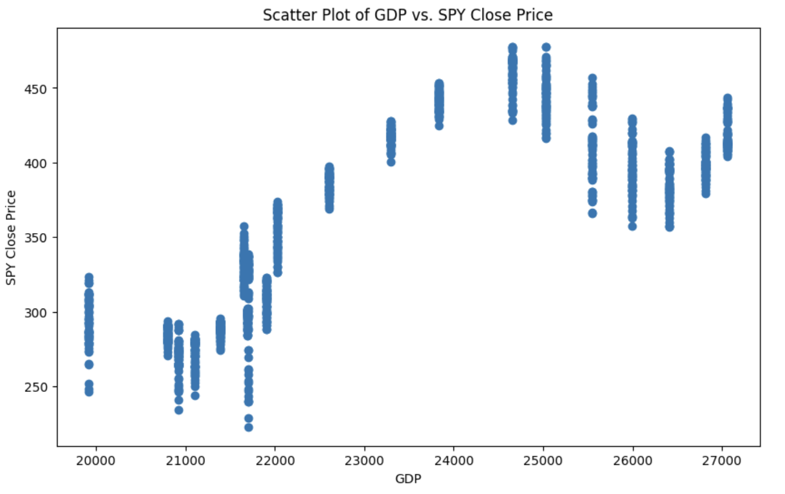
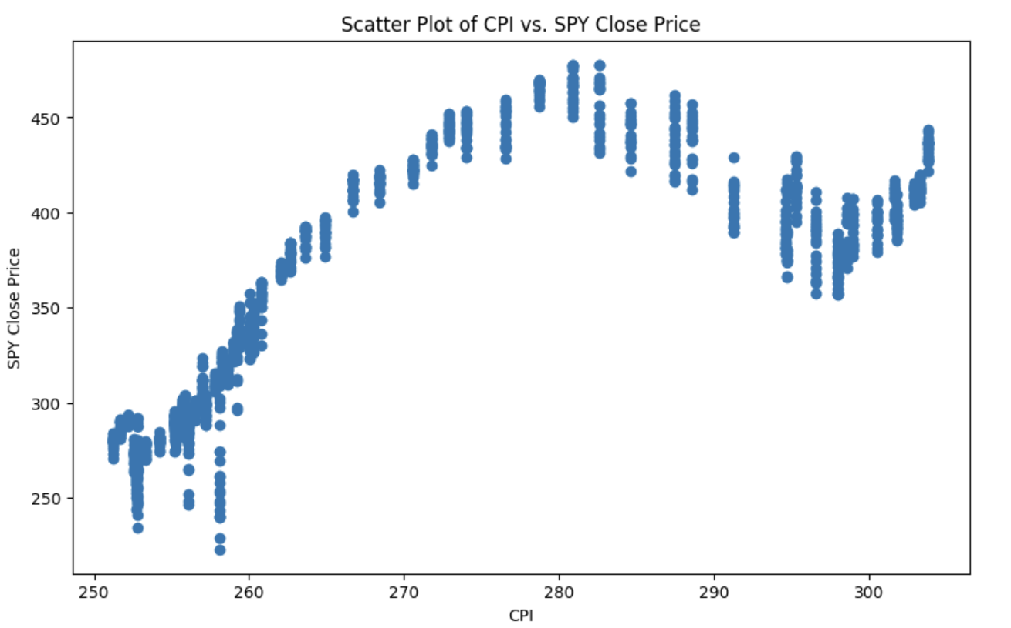
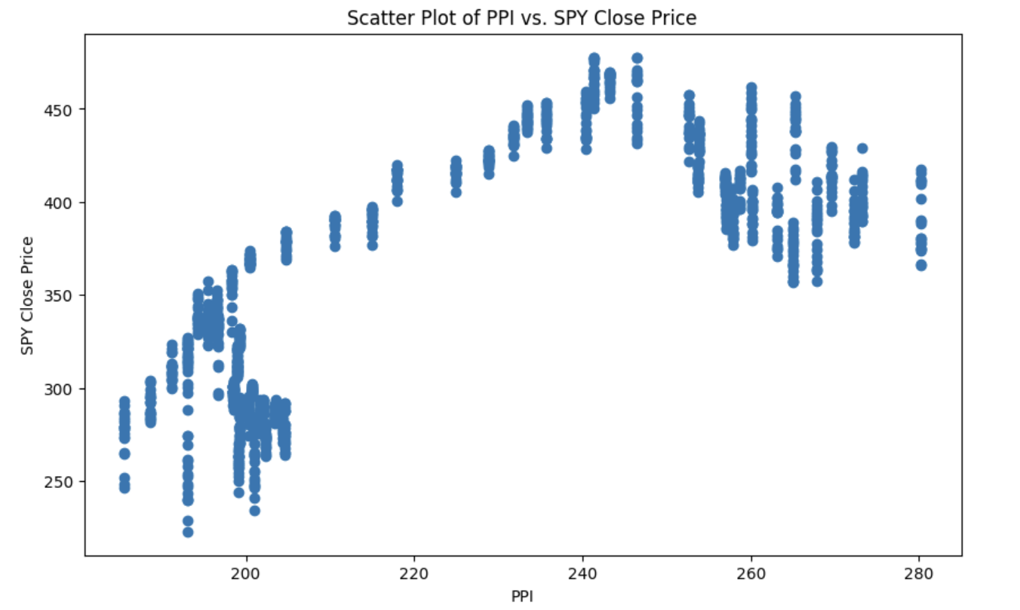
Result
GDP
CPI
PPI
Strong Positive Relationship

Slide 7
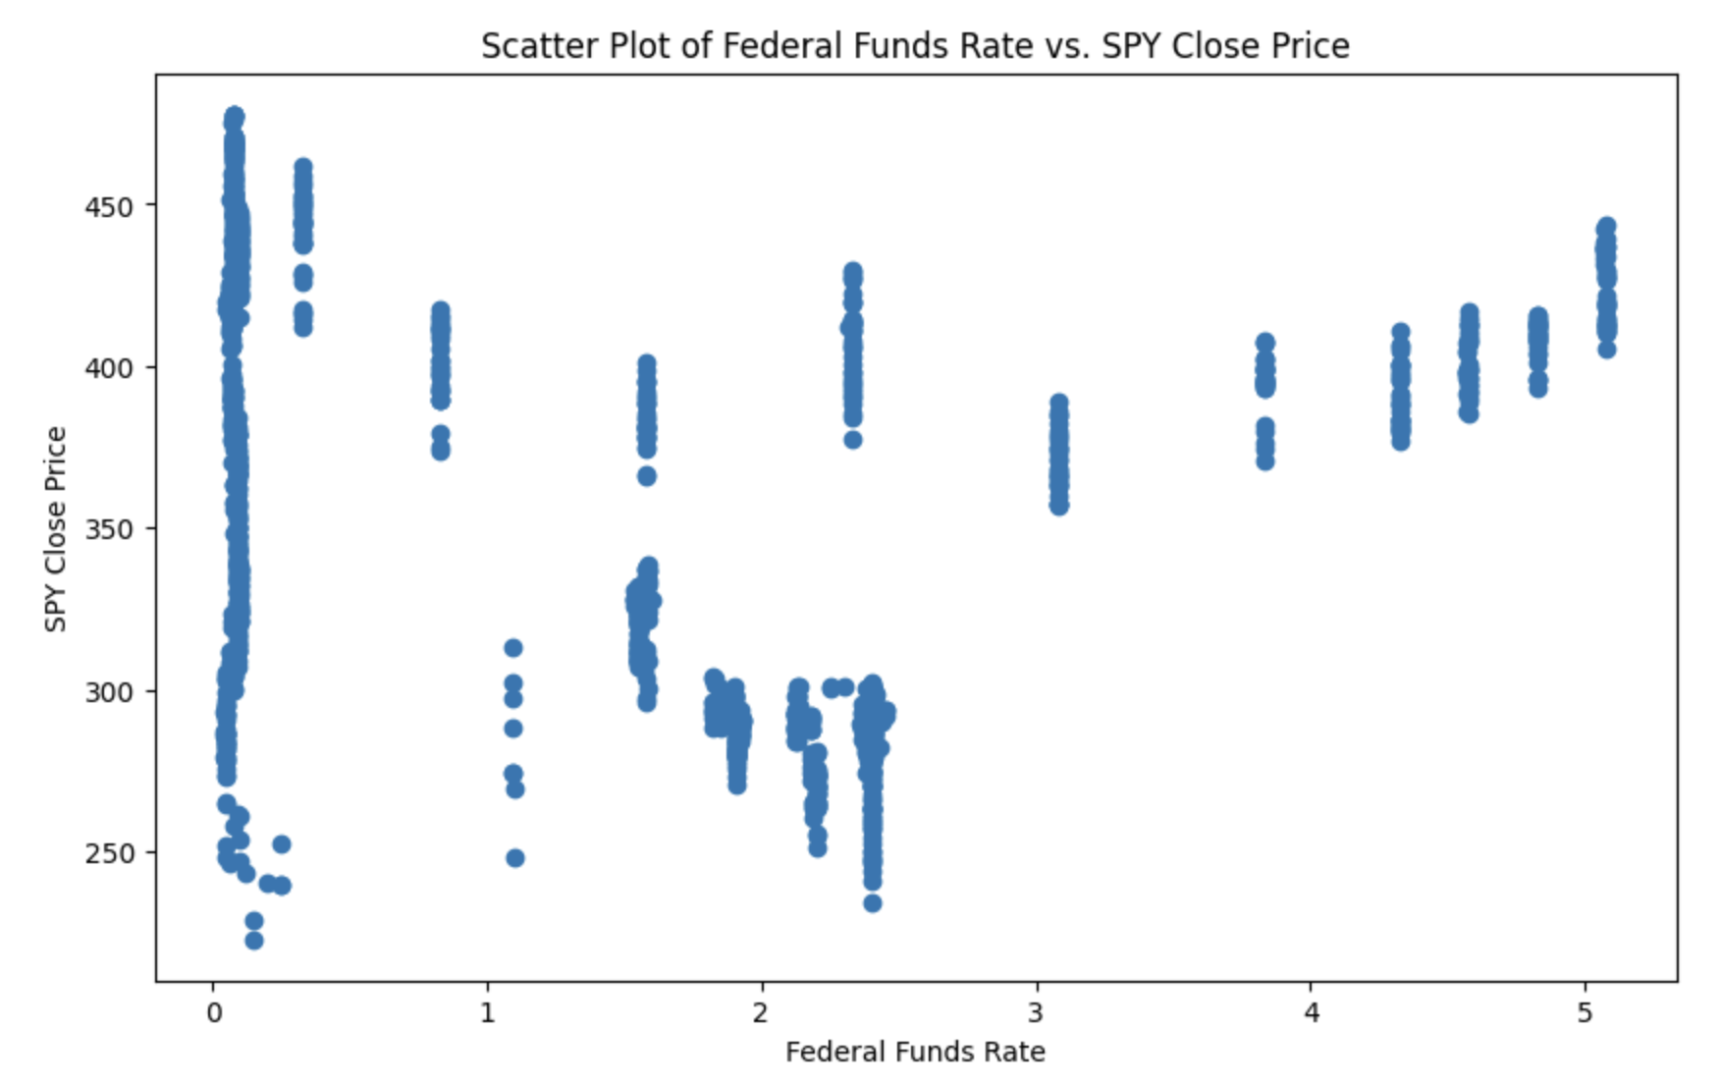
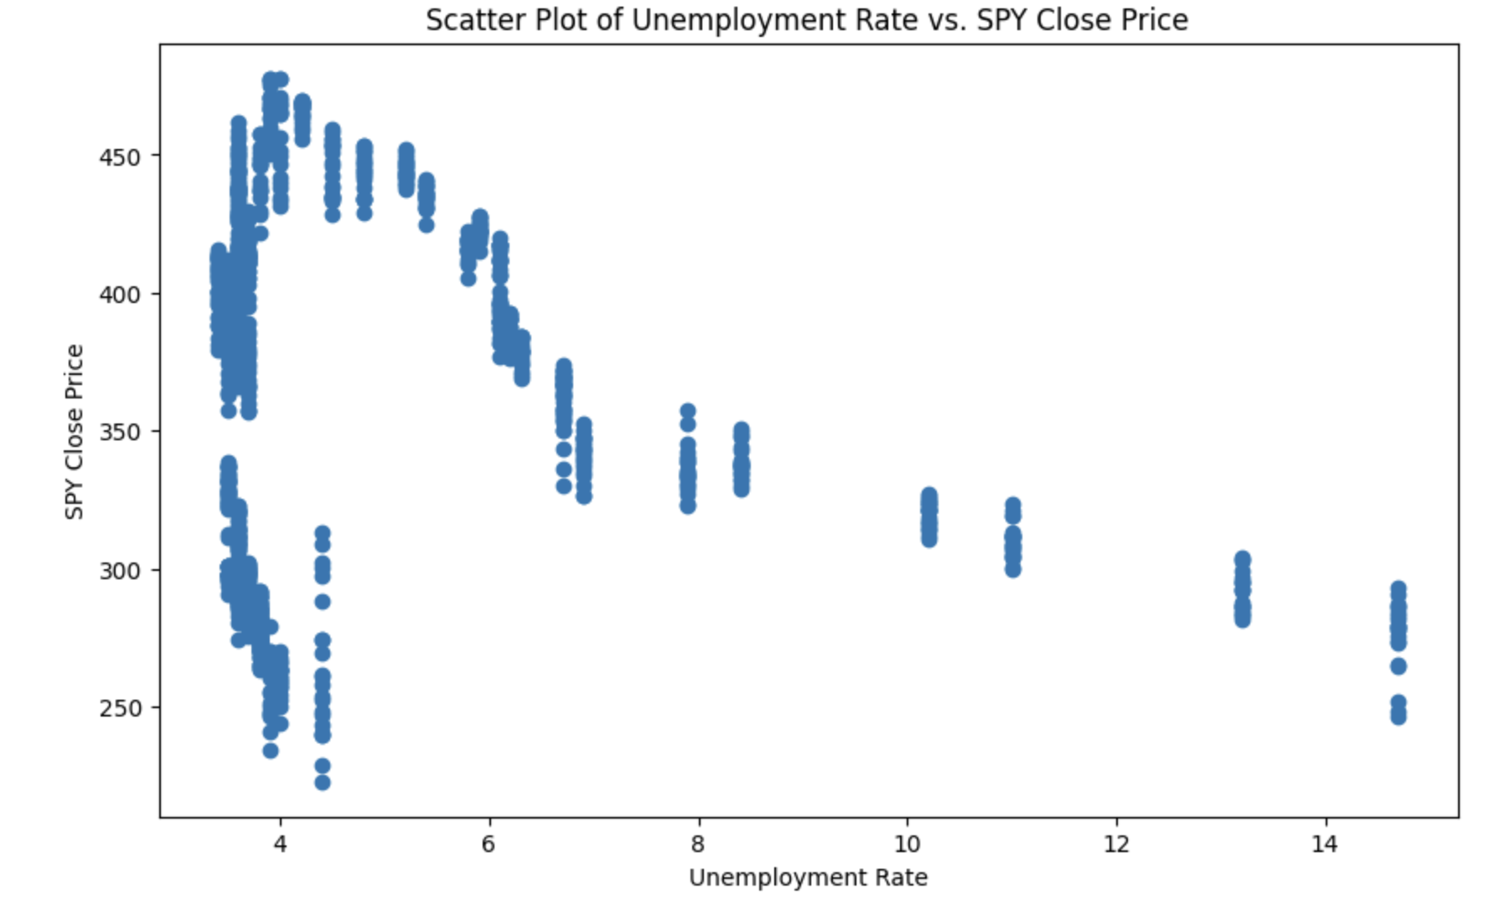
Result
Federal Fund Rate
Unemployment Rate
Weak Negative Relationship

Slide 8
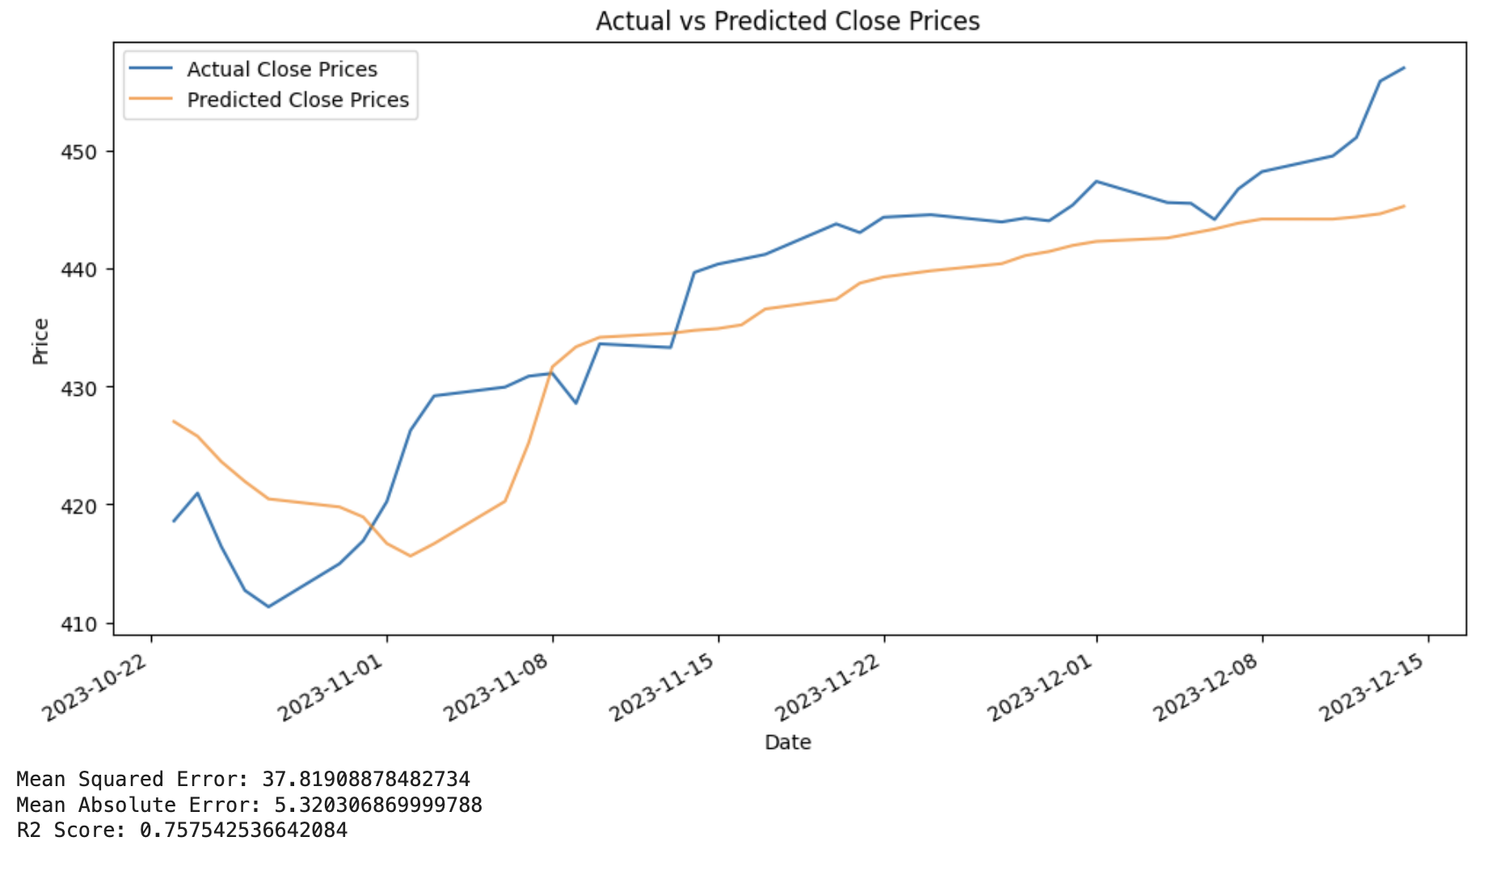
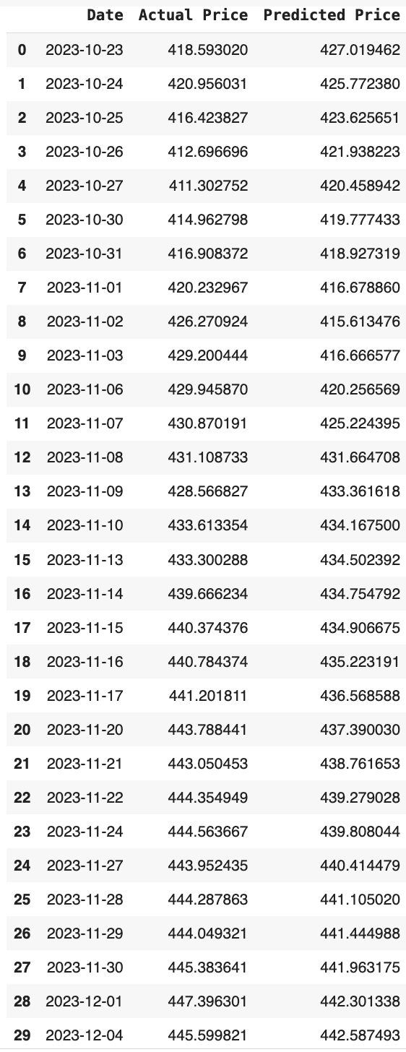
Result
Predictive Model Performance

Slide 9

Conclusion
Impact of External Factors
Influence on stock prices
Model Performance
Improved predictive accuracy with LSTM model
Future Work
Exploring additional indicators and refining model
Limitations
Heavy reliance on historical patterns in a dynamic market

Slide 10

Thank You

Slide 11
Related Work
1. Discolll,N. (2023,May10). StockpricepredictionLSTMhyperparametertuning. Medium. https://medium.com/@redeaddiscolll/stock-price-prediction-lstmhyperparameter-tuning-ad69d409ae29

